Slide 1
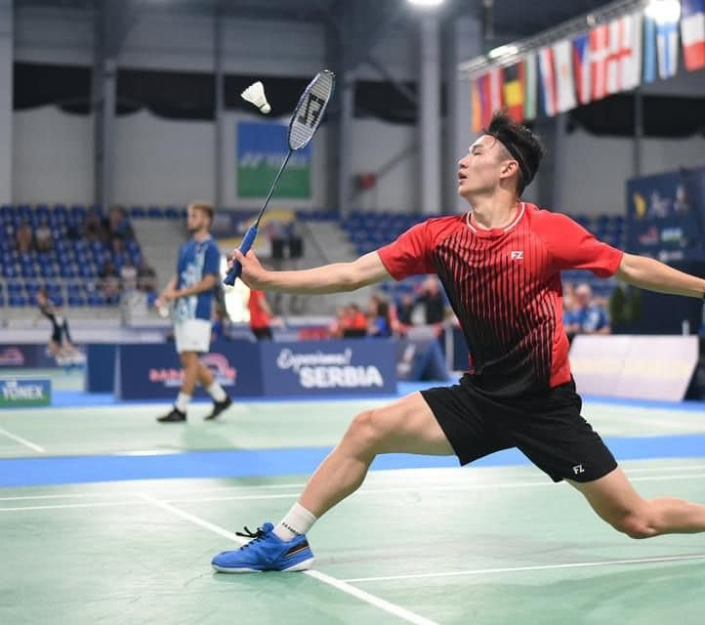
Grants & Funding State of Readiness
Wednesday 6th Dec 2023 7:30pm

Slide 3
Contents
Current Context and Challenges Faced
State of Readiness: Is Your Club FundReady?
Identifying Funding Priorities
Evidencing Need For Funding (important!)
Useful Resources and Discussion

Slide 4
Current Context and Funding Challenges
“We haven’t applied to funding before and don’t really know where to start”
“We have some funding experience but could do with more support on how best to answer application questions”
“We’re not sure how best to source grants and apply for ones that are relevant to us”
What experience(s) has your club had with funding?

Slide 5
First things first: Are you
A well-written grant is time wasted if not accompanied with the required supporting documents
Very commonly asked for:
Signed and dated constitution Annual accounts/financial statements Recent bank statement (within last 3 months) Safeguarding policy (if working with children and/or vulnerable adults)
Sometimes asked for:
Equality policy Committee list with contact details Deeds, lease or rental agreement (for capital projects) Statutory approvals (for capital projects) Quotes (at least two, like-for-like) *Links to policy templates available within notes section of this slide
Notes:
Where can I find templates online?
Tools and resources — NCVO Knowhow
Small Charity Support - Example Policies
Course: Policies and procedures (sportenglandclubmatters.com)

Slide 6
A new fund has opened that looks like it might suit our club – great! But where do I begin?
Read the online summary information
Refer to the fund’s guidance notes
Check what supporting documents are required
Does it align to your funding priorities?
Once you’ve developed your idea – begin writing!

Slide 7
Identifying Your Funding Priorities
It’s important that your club can identify some basic funding priorities. This will help you develop specific actions i.e. potential projects for funding. Consider the following:
What has been delivered in the past 12 months? What worked well?
What are you planning on delivering in 2023? What are the main costs associated with this?
What activities have gained interest or demand recently?
Do you / can you deliver activities in partnership with another group to align with non-sports-focused funding priorities? E.g. mental health, cross-community, good relations, disability & inclusion.

Slide 8
How to Begin Developing Ideas for Projects
WHO - Who are the participants involved in your project?
WHAT - What specific activities are involved?
WHERE - Where does it take place?
WHEN - When does it take place?
WHY - Why is the project needed?

Slide 9
Project Need: why is it so important?
This is often the most heavily weighted assessment criteria in funding applications
It shows funders that your project is participant-led i.e. the people taking part in your project have been involved in the planning and design of activities
Example 1:

Slide 10
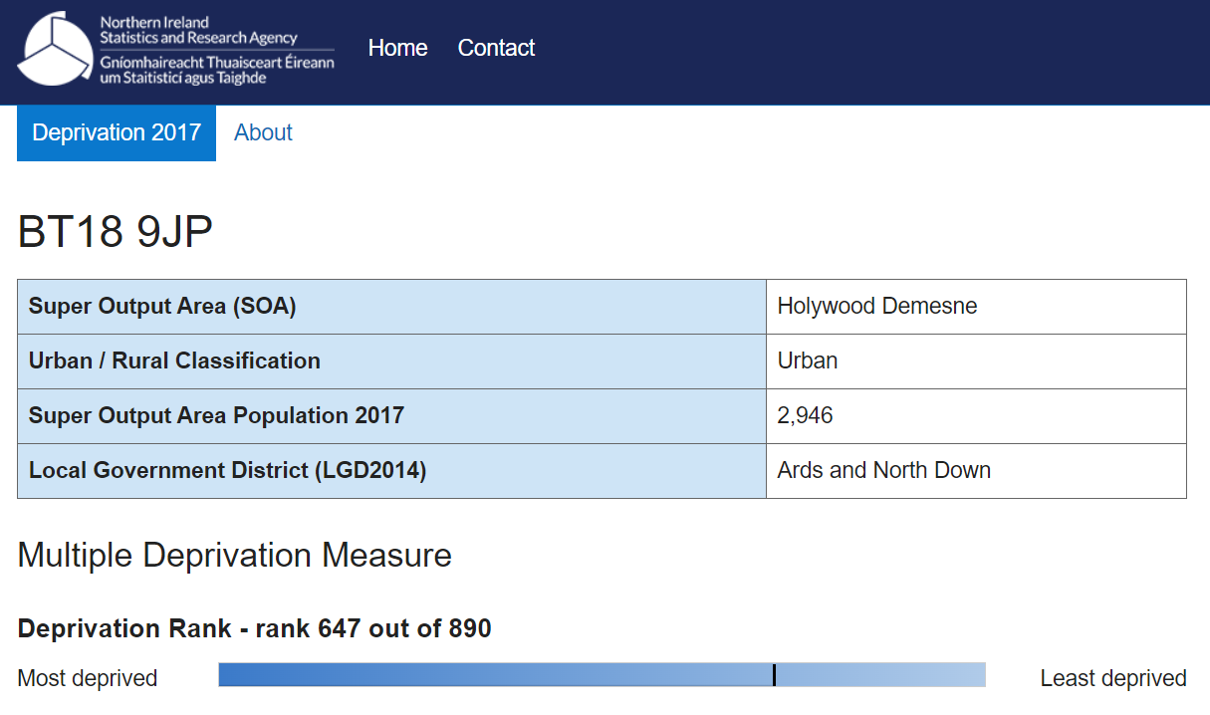
My club is based in a relatively affluent area. Does this mean we can’t access grants?
Using social deprivation statistics is one of a number of ways that your club can evidence need for funding (see next slides)
Notes:
Home Page | NI Area Statistics | NISRA

Slide 11
Project Need: a practical guide
Gathering project need information is also referred to as conducting ‘community consultation’ or a ‘needs analysis’. The good news is that the process can be made much easier than it sounds!
The process should aim to identify the following:
Local issues experienced by the community
Activities or services that people would like to take part in
Develop baseline information for future comparison
1. Informal conversations
2. Online survey
3. Focus groups
Notes:
Note: a combination of informal conversations and an online survey is recommended. Focus groups can then be arranged at a further point when you have gathered a range of findings from the previous stages.

Slide 12
Developing An Online Survey
What questions should I include?
Opening questions – age, gender, ethnicity, location, disability, member/non-member
Main questions (with suggested responses) – issues in the local community, what activities or services would you like to see delivered? Rating of current community/sports provision locally?
Covid-19 related questions (open ended) – this can capture useful information to demonstrate to funders that you have considered newly emerging needs or issues presented by the pandemic. I.e. How has Covid-19 impacted children and young people, older adults etc?
Concluding questions – an opportunity for other comments, suggestions or queries that respondents might have (can lead to new project ideas)
Notes:
Note: try to limit your survey to around 10 questions. This will provide a good balance between getting the info you need and keeping respondents engaged!

Slide 13
Developing An Online Survey
Notes:
Note: if Google Forms or Microsoft forms doesn’t work for you, try a quick Google search for a range of free surveys that can be created from other online resources. Once this process has been completed, it will make things much easier going forward when developing project ideas and making stronger funding applications!

Slide 14
Presenting The Results
Consider use of bullet points to present your summary of findings in a clear and concise way:
ABC Badminton Club launched a community survey in January 2023 to gather the needs and interests of club members, local residents, schools and community groups in our local area. Summary of findings are presented below:
100 individuals completed the survey
65% of respondents identified as members, 35% identified as non-members
‘intro badminton for older adults’ was selected by 70% of respondents as an activity that would benefit the local community
‘new badminton equipment’ was selected by 85% of respondents when asked about club improvement areas
‘mental health’ was the most selected response when asked about key issues in the local community

Slide 15
Useful Resources
Google: [council name] grants and funding
Google: [county name] sports partnership club grants (ROI only)
Funding News — Supporting Communities
FundReady Newsletter
Community Foundation NI
Ulster Badminton / Badminton Ireland resources (Kyle to discuss)

Slide 16
Feel free to ask any questions you may have on any of the topics covered!
20

Slide 17
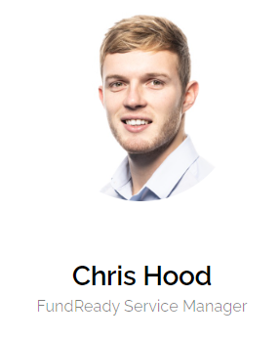
chris@fundready.com
07395 791291

